Slide 1
Fellow Research at the University of Utah
Susan P. Etheridge, MD, FACC
University of Utah and Primary Children’s Hospital

Slide 2
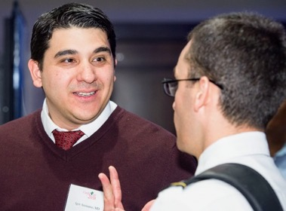
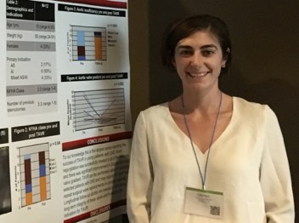
Research Structure
Research Director and team: coordinators and Stats support
Research Boot Camp
Pediatric Cardiology Fellowship Research Night
Spirited Research, monthly research meetings
T-32, MSCI
SOC
Fellows exposure to NIH sponsored PHN, PCGC, SDY, and AHA SFRN
Heart Center Research on a Napkin
Grant writing workshops

Slide 3
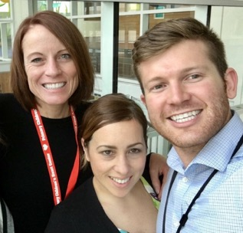
Research Team
Research director to assist the PD and APD to accomplish goal of meaningful fellowship research
Coordinators to assist with IRB - fellows do the “heavy lifting”
Redcap specialists for teaching and support
Statistics support – with office hours for help design and execution
Financial support for meetings when presenting (3 here at ACC)
Regular research nagging emails……
……As per Dr. Etheridge's note, your manuscripts are due today. Please submit them before 5 PM. No exceptions.
Thank you,
LuAnn

Slide 4
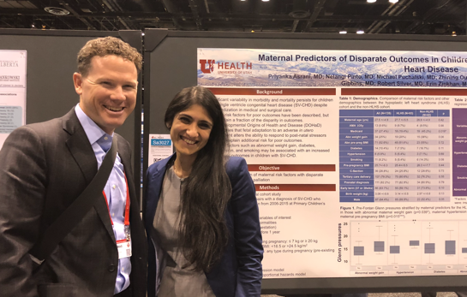
Pediatric Cardiology Fellowship Research Night
Formal presentations by fellows in a fun but formal atmosphere -offsite
Cardiology division in attendance with plans to extend to heart center
3rd year fellows expected to present a 10 minute power point presentation and have a near complete manuscript
2nd year fellows a poster
1st year fellows a formal research project plan

Slide 5
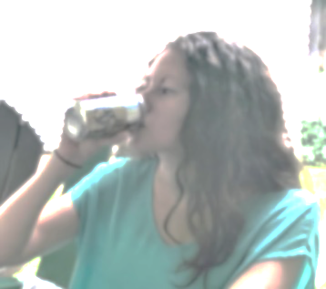
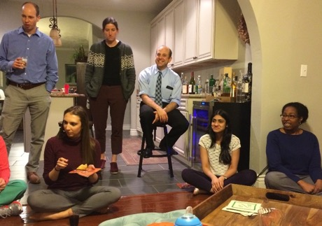
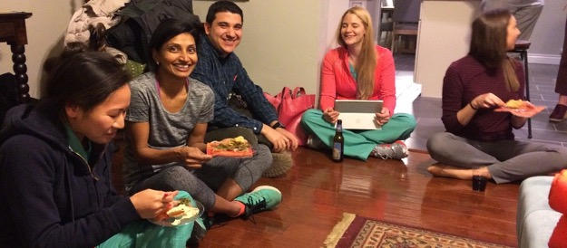
Spirited Research Meeting
Established by the fellows
Fellow president and Faculty advisor:
Faculty-sponsored monthly meetings
Relaxed atmosphere
Fellow-set agenda
Abstract revisions
Potential projects
Potential mentors and research team building
Impediments
Grant review/revisions

Slide 6
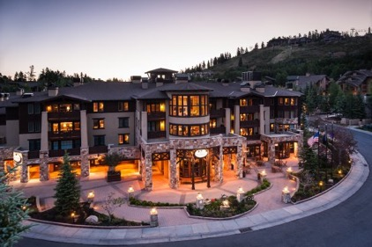
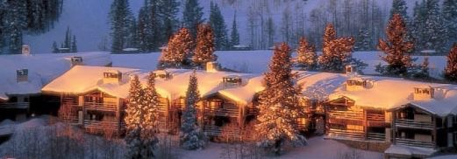
Grant Writing Workshops
Dept of Pediatrics sponsored
Deer Valley in Spring and Fall
Specific Aims done in advance
Assistance with grant for funding source identified

Slide 7
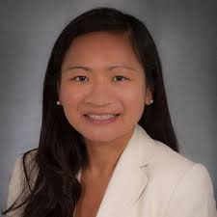
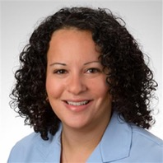
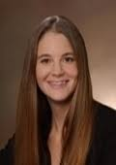
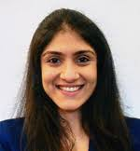
Masters in Clinical and Scientific investigation
Offered to 1 fellow/year
Plans for career in clinical research
Theories, models, methods, competencies, and tools
20 core/elective classroom hours
Mentored clinical research project
Division sponsored

Slide 8
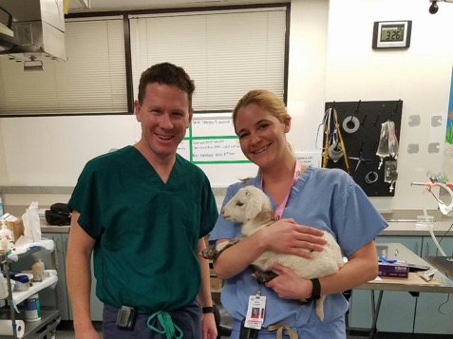
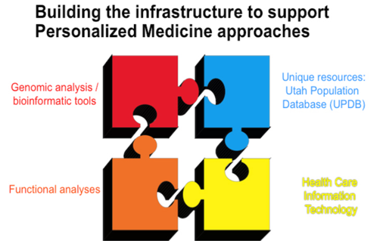
Opportunities
U of Utah or Intermountain labs
Basic science, translational and outcomes research
Population science
Utah population database
Multidiscipline teams
Genetics
Personalized medicine

